Slide 1
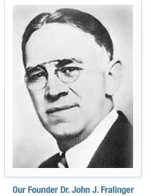
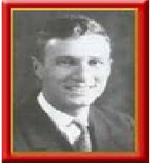
History Of The Ferko and Fralinger String Bands
John Fralinger was a well known Pharmicist
Joe Ferko was his assistant
Fralinger decided to fund a string band in the 1915 Mummers Parade
Ferko was the captain
In 1922 Ferko founded his own pharmacy and created his own string band
The Fralinger String Band folded
During the 1940s through the 1960s, The Ferko String band dominated its competition

Slide 2
History Of The Ferko and Fralinger String Bands

