Slide 1
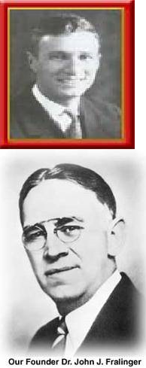

History Of The Fralinger and Ferko String Bands
Fralinger was a pharmacist with a Pharmacy shop in Phila
In 1915 created the Fralinger String Band to march in the first String Band component of the Mummer’s parade
First captain was Joe Ferko, a pharmacy assistant to Fralinger
Ferko leaves in 1923 to start own band and pharmacy
Ferko becomes very creative with his band inaugurating choreography, music prep and timed routines
Ferko dominates String band competition during the Twentieth century
John Fralinger
Fralinger String Band
Joe Ferko
Ferko String Band

Slide 2
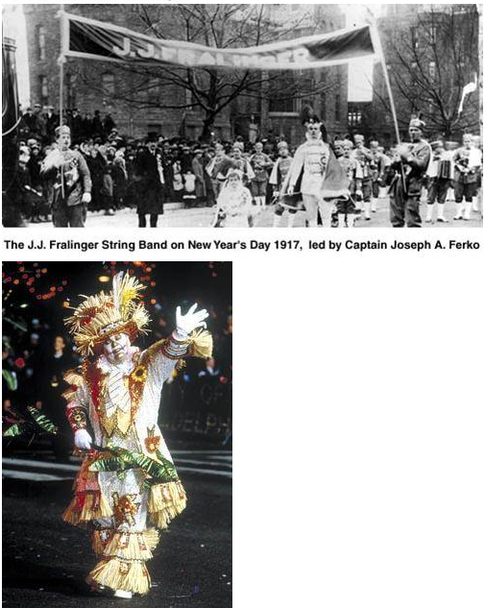
History Of The Fralinger and Ferko String Bands
The Fralinger band is disbanded soon after Ferko leaves
In 1941 some renegade Ferko members and the Fralinger family recreatre the Fralinger band
In the 1970’s the Fralinger family again regain control
In the 21st century, the Fralinger band has won a majority of Mummer day parade String band competitions
Fralinger today is the prototype for a successful String Band

